Slide 1
Data Preprocessing

Slide 2
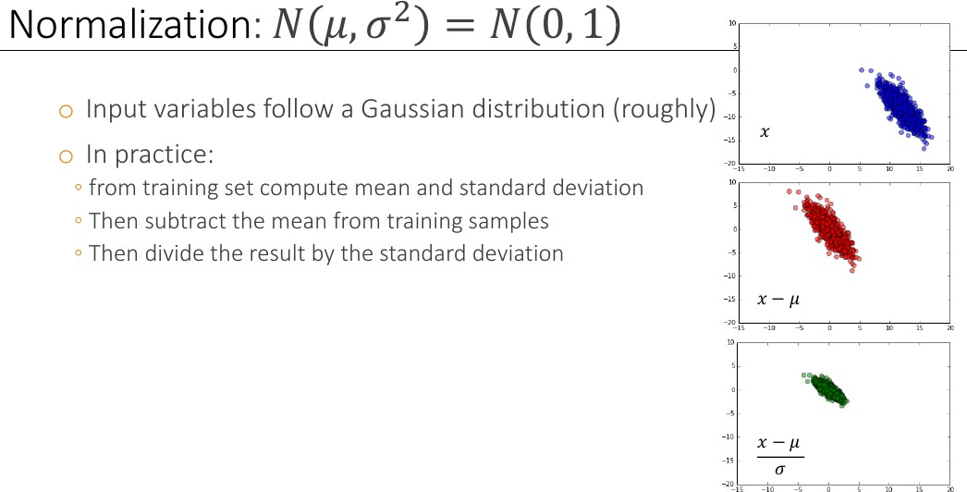
Data Preprocessing

Slide 3
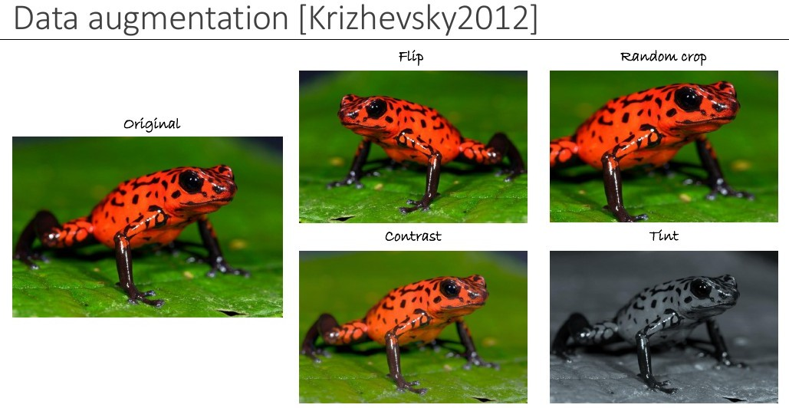
Data Preprocessing

Slide 4
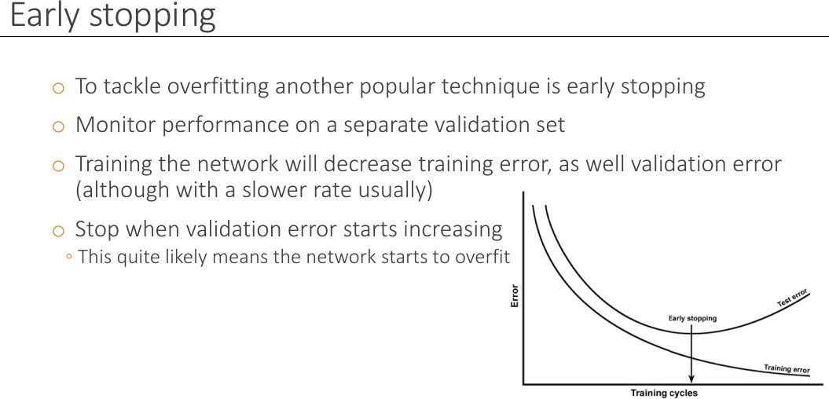
Early Stopping

Slide 5
Drop Out

Slide 6
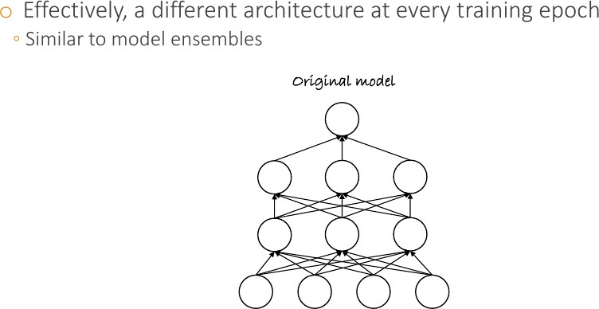
Dropout

Slide 7
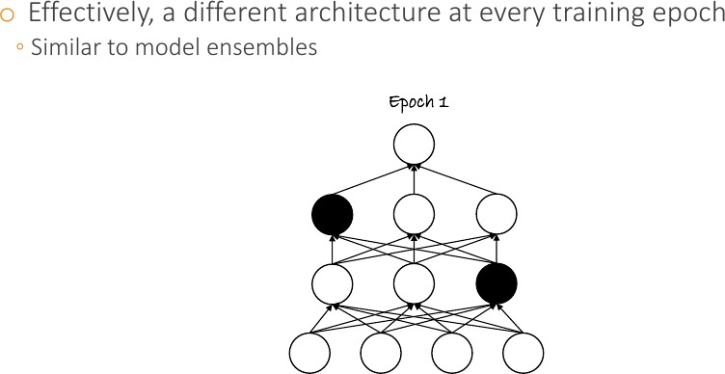
Dropout

Slide 8
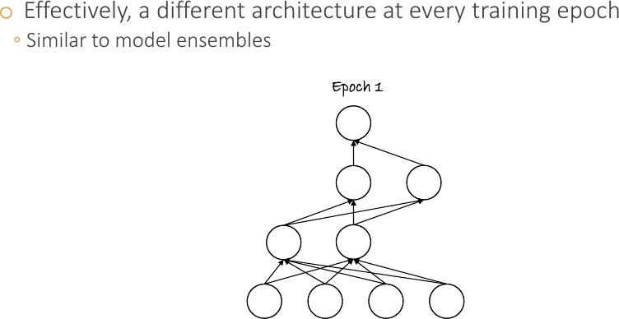
Dropout

Slide 9
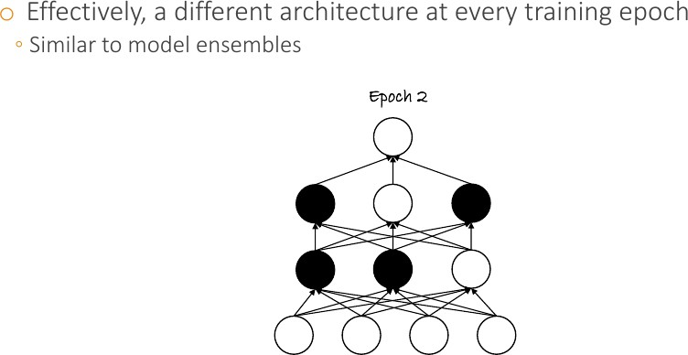
Dropout

Slide 10
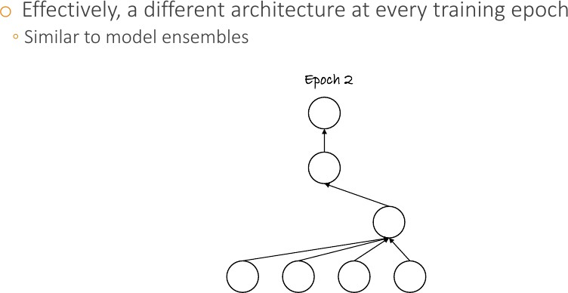
Dropout

Slide 11
Activaton Functions

Slide 12
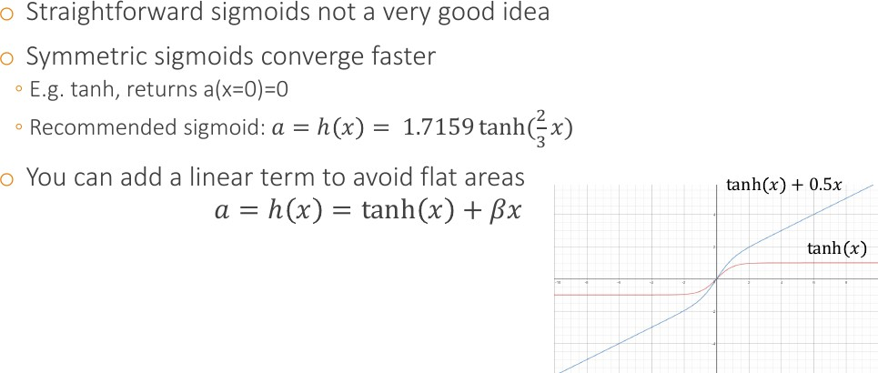
Segmoid-Like Activation Fn

Slide 13
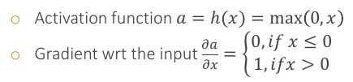
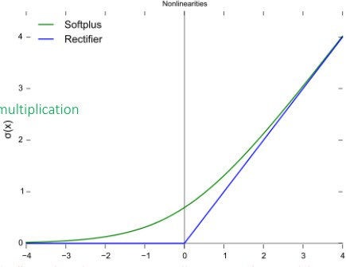
Rectified Linear Unit (ReLU)
●
Very popular in computer vision and speech recognition
Much faster computations, gradients
No vanishing or exploding problems, only comparison, addition, multiplication
People claim biological plausibility
No saturation
●
●
●
●

Slide 14
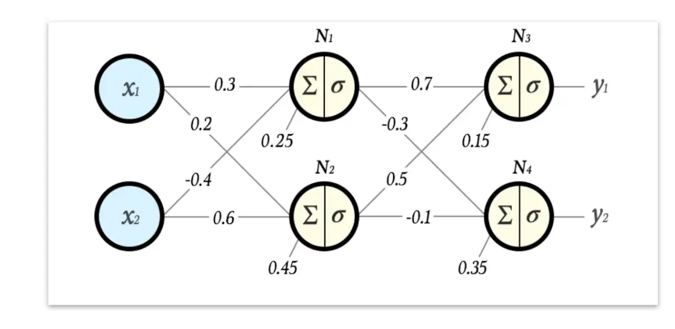

Slide 15
Input Image
28*28 pixels, 3 Channels
28*28*3
Input Image
32 Filters
[5*5] *3
32 Feature map
Convolute with 32 Filters, Each is 5*5*3
[5*5] *3
[5*5] *3
28*28
28*28
28*28
O/P is 32 images Each is 28*28 (use padding)
Feature Map
ReLU (Activation Fn) 2 * 2 * 1 pooling
ReLU Activation Fn Then Pooling (2*2)
32 Feature map
14*14
14*14
14*14
14*14
O/P (after pooling)
32 images each 14*14 pixels
64 Filters
Convolute 32 images with 64 Filters, Each is 5*5*32
5*5
*32
5*5
*32
5*5
*32
5*5
*32
64 Feature map
14*14
14*14
14*14
14*14
O/P is 64 images Each is 14*14 (use padding)
Feature Map
ReLU (Activation Fn)
ReLU Activation Fn Then Pooling (2*2)
2 * 2 * 1
pooling
64 Feature map
 | 7*7 |  | 7*7 |  | 7*7 |  | 7*7
O/P (after pooling)
64 images each 7*7 pixels

Slide 16
64 Feature map
7*7
7*7
7*7
7*7
O/P (after pooling)
64 images each 7*7 pixels
7x7x64 values
…………………………………………..
Flaten to one Feature Vector Size 7*7*64
Fully connected (FC) Hidden Layer (1024 Neurons)
Hidden layer
1024
10
Fully connected (FC) Output Layer (10 Neurons)
O/P layer
Softmax
Softmax Activation function, One-Hot output
Cross Entropy
Error
Loss Function
Training data Labels (One-Hot Labels)
Training Labels

Slide 17
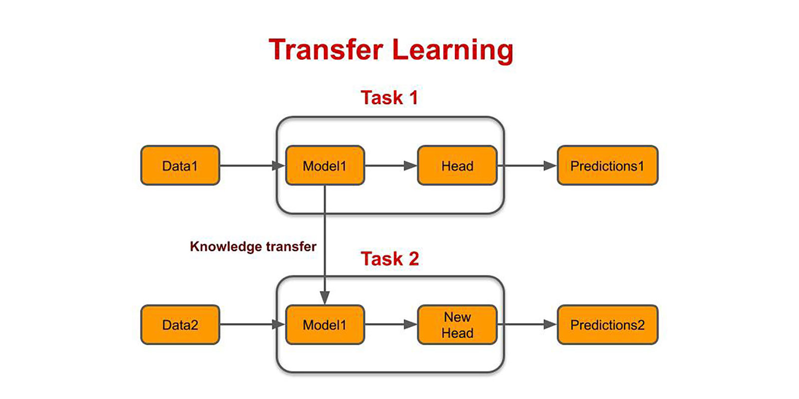

Slide 18
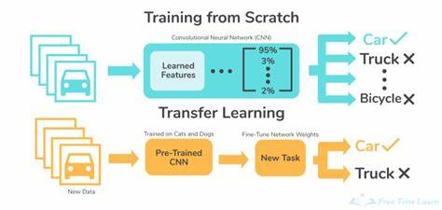

Slide 19
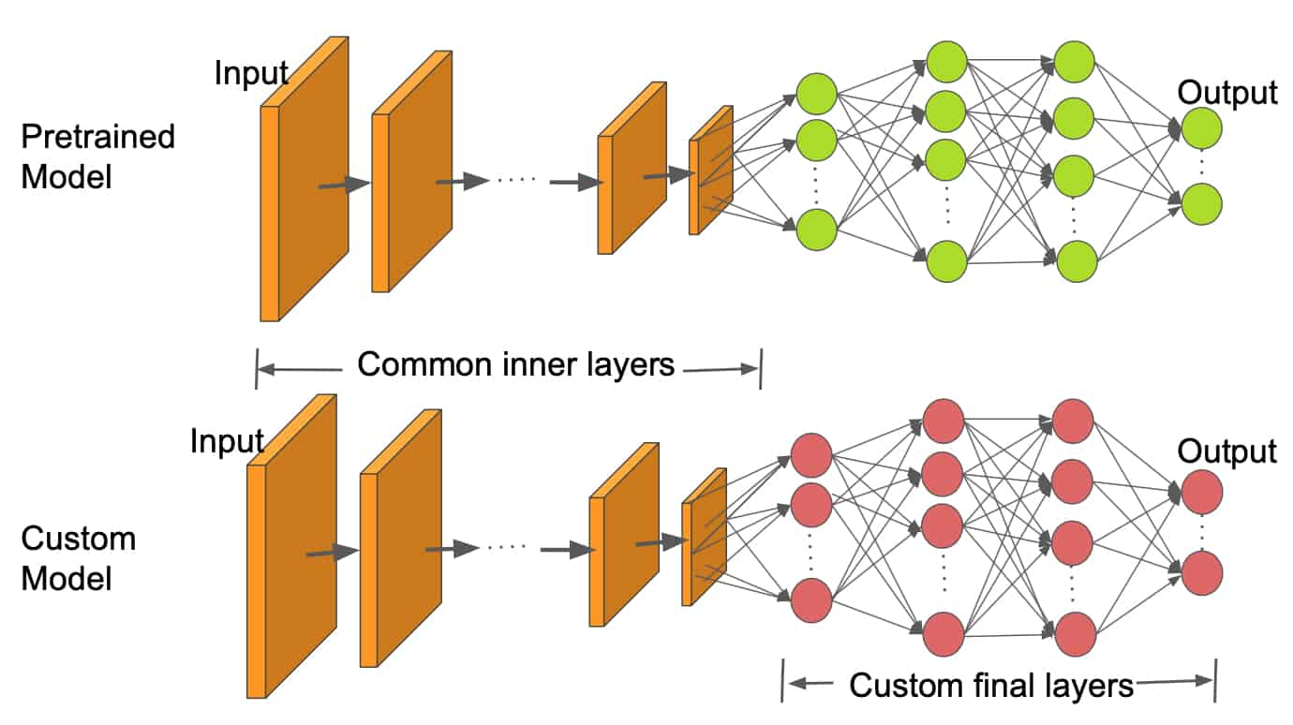

Slide 20
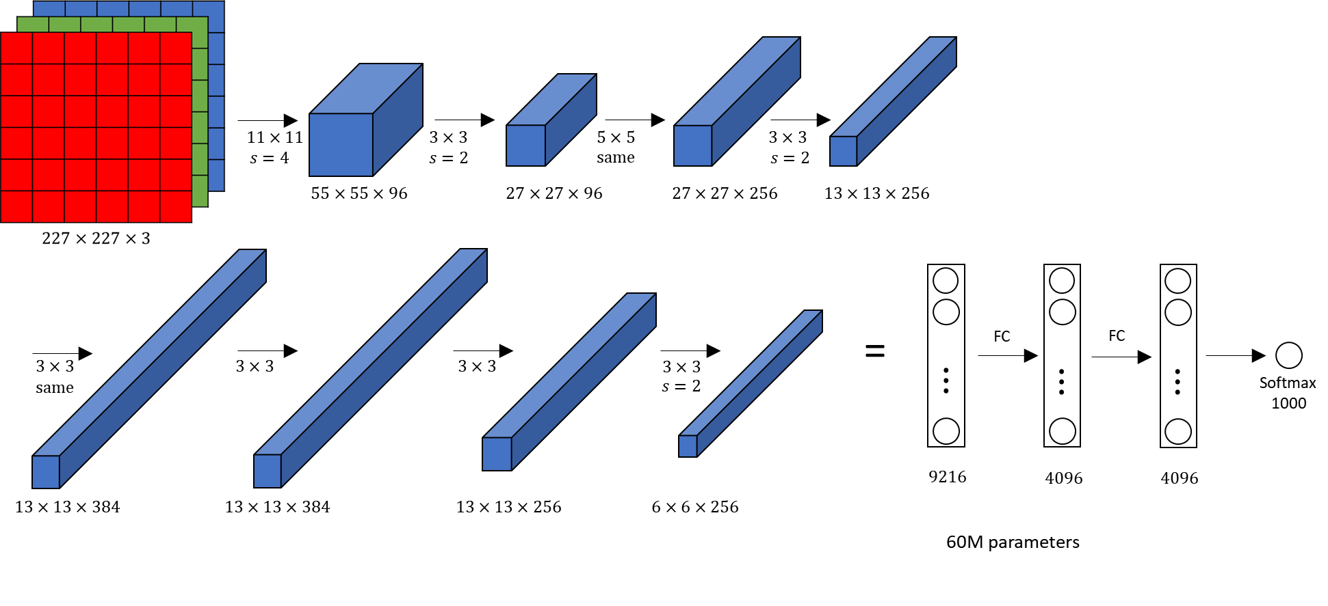

Slide 21
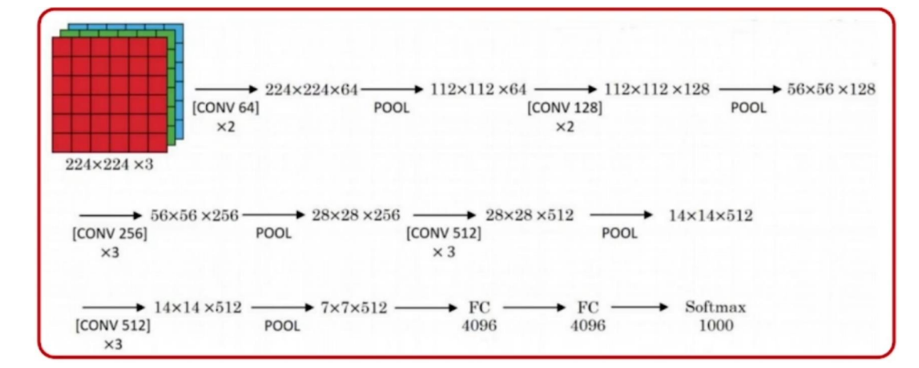

Slide 22
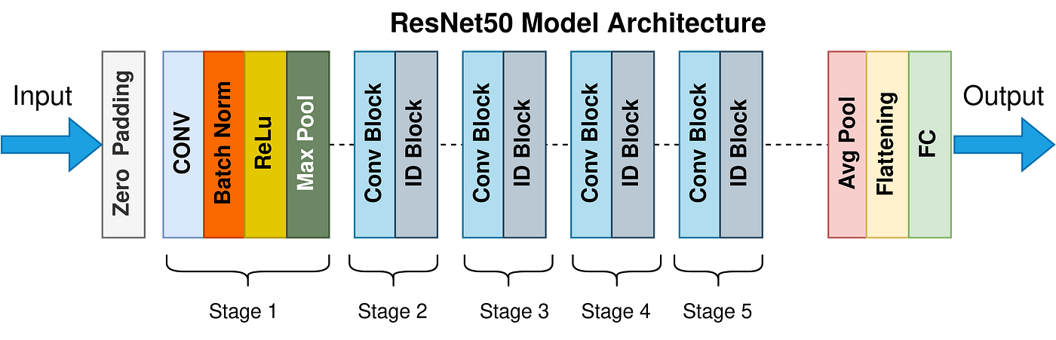

Slide 23
